Slide 1
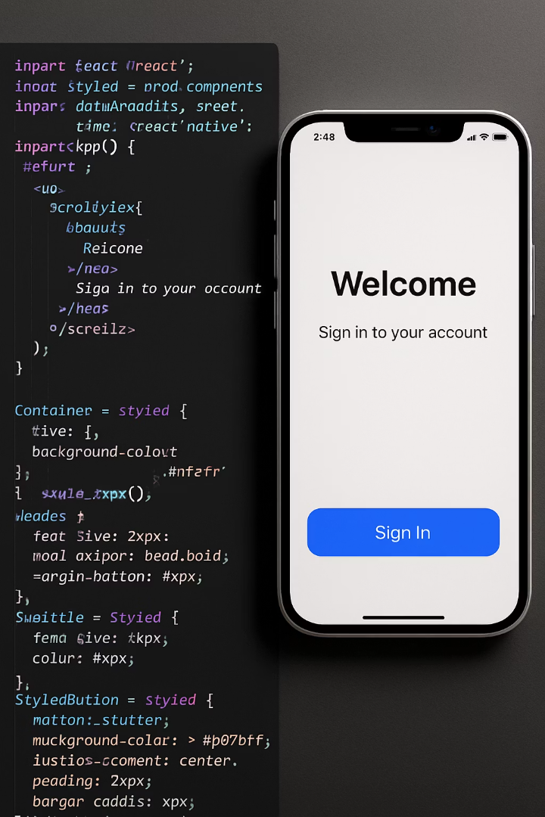

Styled-Components in React Native
Welcome to our exploration of Styled-Components in React Native. We'll dive into how this powerful library can transform your styling workflow, making it more intuitive and maintainable.

Slide 2


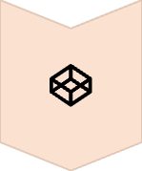


What We'll Cover
What are Styled-Components?
Core concepts and advantages
Getting Started
Installation and basic setup
Practical Examples
From basic to advanced patterns
Best Practices
Tips for production apps

Slide 3
What are Styled-Components?
Definition
Key Innovation
A CSS-in-JS library that lets you write actual CSS in your JavaScript. It enables component-level styling in React Native applications.
Uses tagged template literals to attach styles directly to component definitions. This creates a tight coupling between components and their styles.

Slide 4




Why Choose Styled-Components?
Scoped Styles
Dynamic Styling
Styles are tied to specific components. This prevents the styling conflicts common in larger applications.
Easily adjust styles based on props. This creates adaptable UI components that respond to state changes.
Clean Code Structure
Keep styles and component logic together. This improves readability and maintainability.

Slide 5

Benefits for Teams
Improved Component Reusability
Easier Maintenance
Better Collaboration
When styles live with components, updating one component doesn't unexpectedly affect others.
Developers and designers can work more closely together with a component-based approach to styling.
Create a library of styled components that can be reused throughout your application, ensuring consistency.

Slide 6

Installation & Setup
Install the Package
Run this command in your project directory:
npm install styled-components
Add TypeScript Types (Optional)
For TypeScript projects:
npm install @types/styled-components @types/styled-components-react-native
Import in Your Component
Add the import statement:
import styled from 'styled-components/native';

Slide 7
Basic Syntax
Creating a Styled Component
Using Your Component
const Button = styled.TouchableOpacity`
background-color: #3498db;
padding: 10px 15px;
border-radius: 5px;
`;
return (
<Button>
Press Me
</Button>
);

Slide 8
Dynamic Styling with Props
Defining Props-Based Styles
Using Props in Components
const Button = styled.TouchableOpacity`
background-color: ${props =>
props.primary ? '#3498db' : '#e74c3c'};
padding: 10px 15px;
border-radius: 5px;
`;
// Primary button (blue)
<Button primary>
Submit
</Button>
// Default button (red)
<Button>
Cancel
</Button>

Slide 9
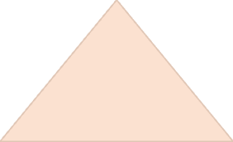

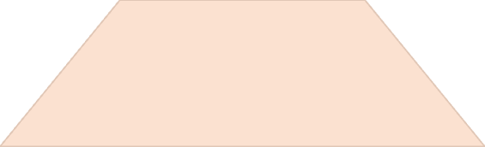

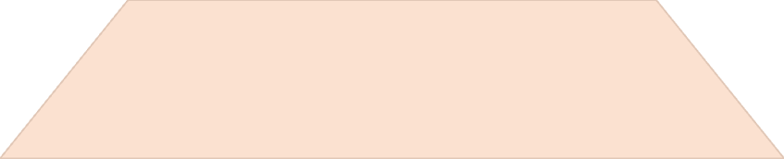

Extending Styles
Complex Components
Build feature-rich UI elements
Extended Components
Add styles to existing components
Base Components
Start with foundational elements

Slide 10

Extending Example
Base Button
Primary Button
const Button = styled.TouchableOpacity` padding: 10px 15px; border-radius: 5px; `;
const PrimaryButton = styled(Button)` background-color: #3498db; color: white; `;
Success Button
Danger Button
const SuccessButton = styled(Button)` background-color: #2ecc71; color: white; `;
const DangerButton = styled(Button)` background-color: #e74c3c; color: white; `;

Slide 11



Theming in Styled-Components
Apply Theme
Use theme values in components
Create Components
Build using theme variables
Define Theme
Set up colors and values

Slide 12
Implementing Themes
Define Your Theme
Wrap with ThemeProvider
const lightTheme = {
background: '#ffffff',
text: '#000000',
primary: '#3498db'
};
const darkTheme = {
background: '#121212',
text: '#ffffff',
primary: '#2980b9'
};
import { ThemeProvider } from 'styled-components/native';
export default function App() {
const [isDark, setIsDark] = useState(false)
return (
<ThemeProvider theme={isDark ? darkTheme : lightTheme}>
<button onClick={() => setIsDark(!isDark)}>
Toggle {isDark ? "Light" : "Dark"} Mode
</button>
{/* Your app content here */}
</ThemeProvider>
)
}

Slide 13
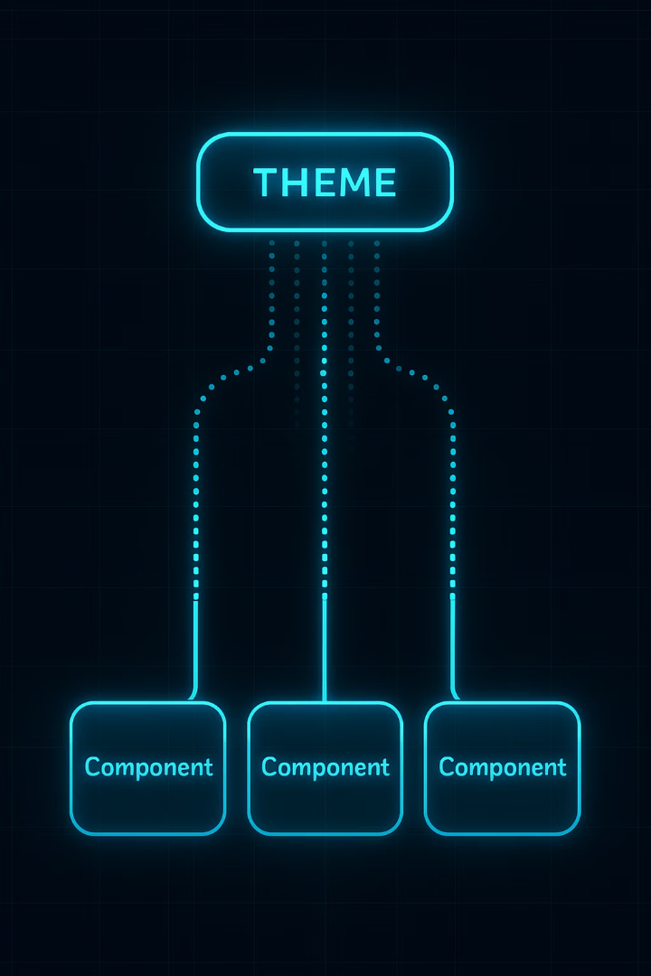


Using Theme in Components
Access Theme in Styled Components
const Container = styled.View`
background-color: ${props => props.theme.background};
padding: 20px;
`;
Access Theme in Regular Components
import { useTheme } from 'styled-components/native';
function MyComponent() {
const theme = useTheme();
return (
<Container>
<Text style={{ color: theme.text }}>Themed Text</Text>;
</Container>
);
}

Slide 14




Global Styles
Consistent Styling
Maintain a uniform look across your entire application with shared style definitions.
Centralized Changes
Update styles in one place and see changes reflect throughout your app.
Reusable Patterns
Create styling mixins that can be composed into various components.

Slide 15
Creating Global Styles
Define Global Styles
Import and Use
// styles.js
import { css } from 'styled-components';
export const shadowEffect = css`
shadow-color: #000;
shadow-offset: 0px 2px;
shadow-opacity: 0.25;
shadow-radius: 3.84px;
elevation: 5;
`;
export const flexCenter = css`
display: flex;
align-items: center;
justify-content: center;
`;
import { shadowEffect, flexCenter } from './styles';
const Card = styled.View`
${shadowEffect}
${flexCenter}
background-color: white;
border-radius: 10px;
padding: 20px;
`;

Slide 16
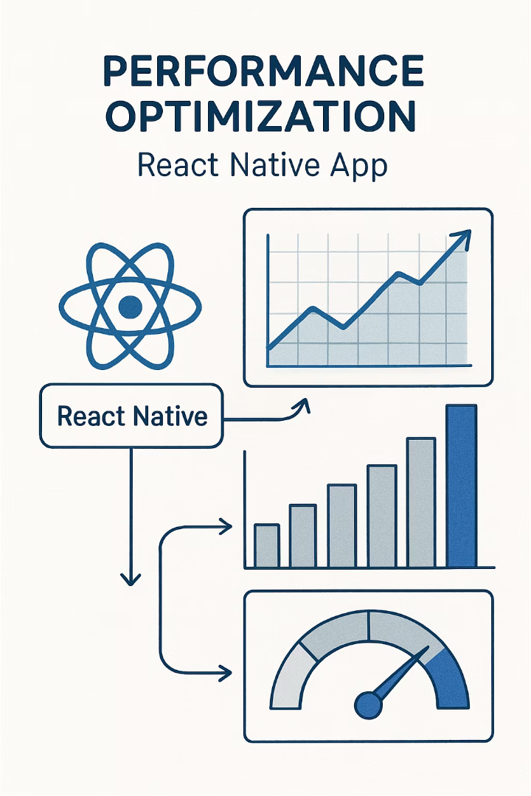
Performance Considerations
—
—
Faster Development
Potential Overhead
Component-based styling speeds up development workflow
CSS-in-JS can add minimal runtime cost
100%
Compatibility
Works across all React Native platforms

Slide 17
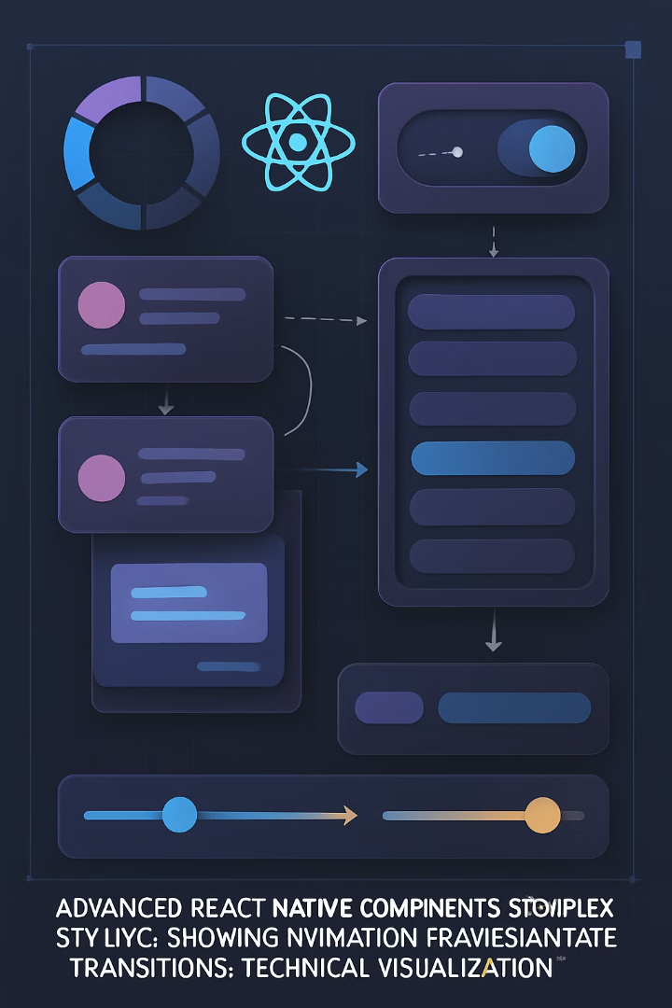
Advanced Techniques
Technique
Use Case
Complexity
Styled Function
Custom component styling
Medium
CSS Helper Functions
Reusable style snippets
Low
Theme Context Manipulation
Dynamic theme switching
High
Style Interpolation
Animation and transitions
Medium

Slide 18

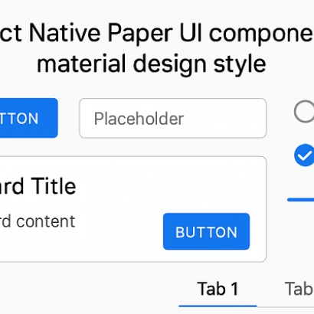
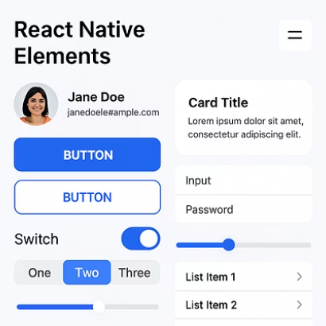

Styled-Components + Libraries
Styled-components works seamlessly with popular React Native libraries. You can style third-party components using the same patterns you use for native ones.

Slide 19
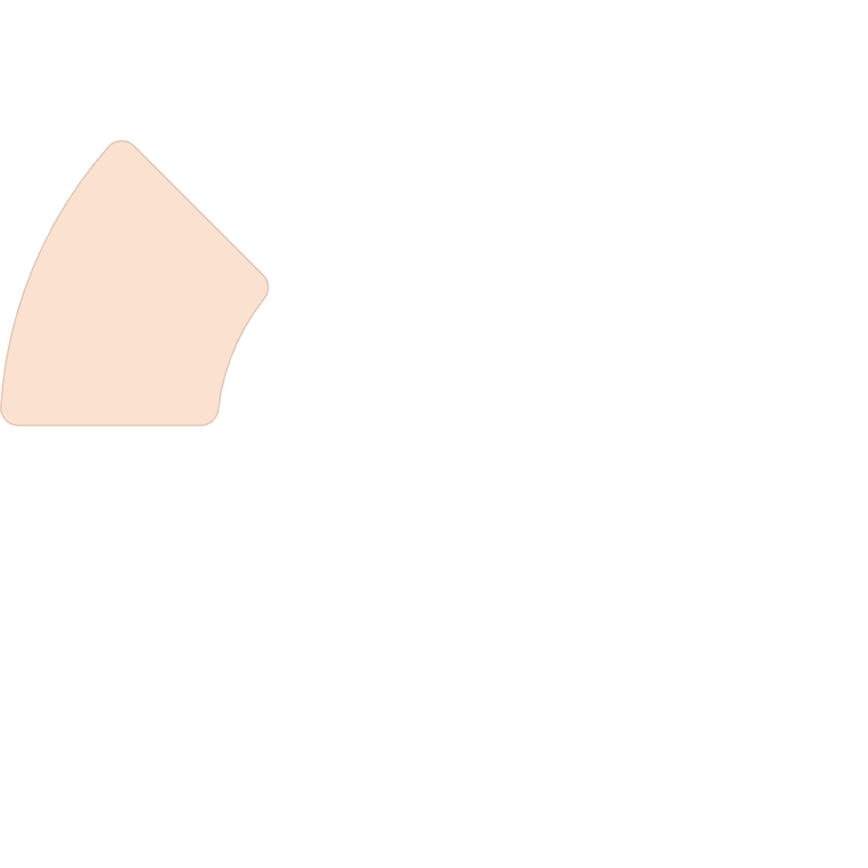
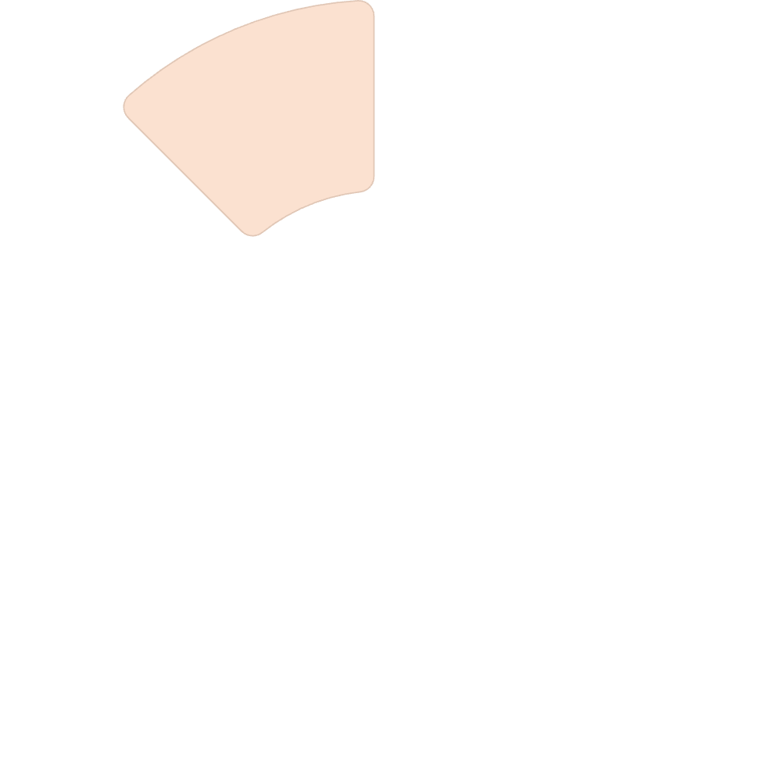
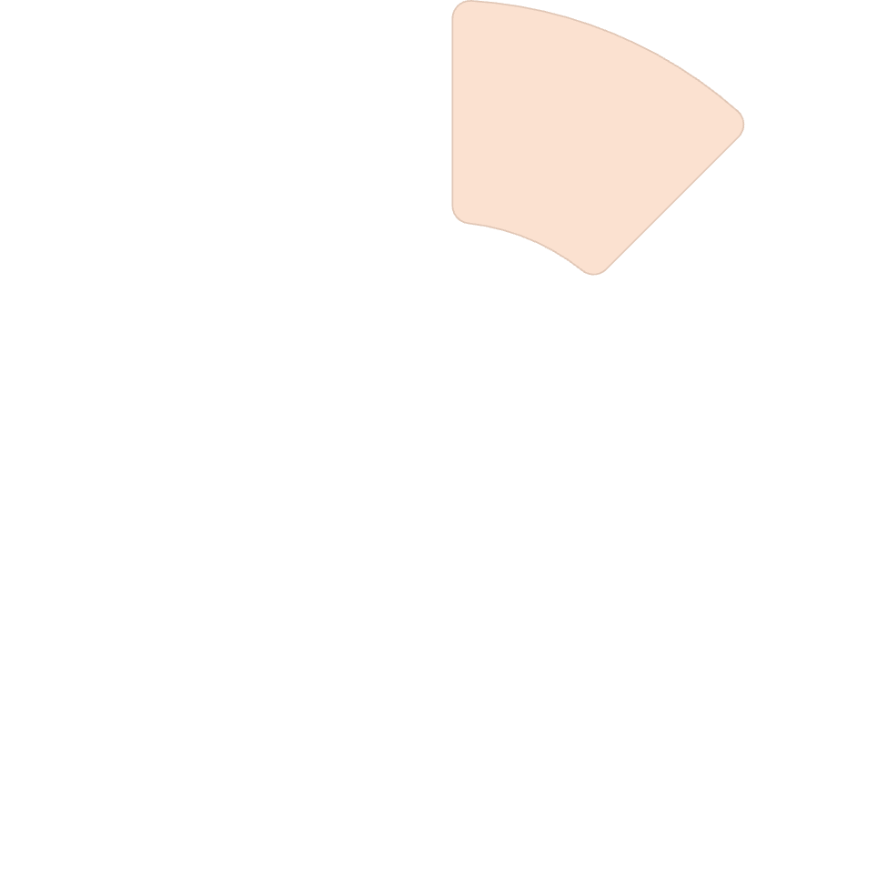





Common Pitfalls to Avoid
Prop Overuse
Large Style Files
Recreating Components
Passing too many styling props creates complex, hard-to-maintain components. Use composition instead.
Keeping all styled components in a single file hurts maintainability. Split logically by feature.
Creating styled components inside render methods causes performance issues. Define them outside component scope.
Missing Native Props
Remember to forward all required props like onPress to underlying native components.

Slide 20





Key Takeaways
Component-Centric Styling
Styled-components keeps your UI code clean by attaching styles directly to component definitions.
Dynamic & Adaptable
Use props and themes to create flexible components that adapt to different states and preferences.
Powerful Composition
Extend existing components to build a consistent, reusable component library for your app.
Production-Ready
Styled-components is mature and ready for production use in React Native projects of any size.

